Slide 1
MOVIE RECOMMENDATION SYSTEM
NAVANEETH RAJ R
YADHU KRISHNAN V A
SREENANDH PREneesh
NAYIF MUHAMMED C M
GUIDE – MS DONEY DANIEL

Slide 2
INTRODUCTION
The microproject aims to develop a movie recommendation system to assist users in discovering new films based on their preferences.
Machine learning techniques will be employed to analyse user preferences and recommend relevant movies accordingly.
Notes:
2

Slide 3
OBJECTIVES :
Develop a collaborative filtering-based recommendation system capable of accurately predicting user preferences.
Evaluate the performance of the recommendation system using metrics such as precision, recall, and Mean Absolute Error (MAE).
Integrate the recommendation system into a user interface for seamless interaction and movie discovery.
Notes:
3

Slide 4
PROPOSED SYSTEM
The proposed system will utilize collaborative filtering techniques, like user-base approach, to generate movie recommendations.
Historical user rating data will be used to build a user-item matrix, where each entry represents the rating given by a user to a movie.
Predictions for unrated movies will be generated based on the learned latent factors, and top-N recommendations will be provided to users.
Notes:
4

Slide 5
HARDWARE AND SOFTWARE REQUIREMENTS
Hardware: A standard computer with sufficient processing power and memory for training the machine learning model.
Software: Python programming language, along with libraries such as pandas and NumPy for data manipulation and model building. Additionally implementation of the UI using HTML and StreamLit Python Library.
Notes:
5

Slide 6

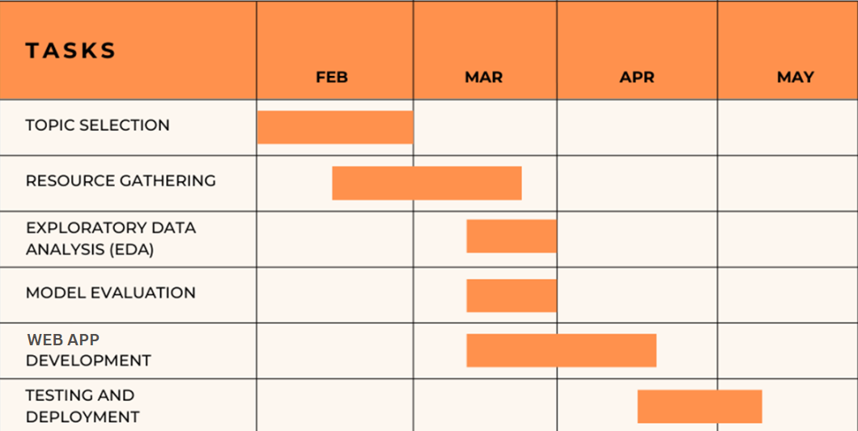

Slide 7
CURRENT PROGRESS
Collected data sets and other necessary materials such as: CSV FILES, FRAMEWORKS and implementing it in GOOGLE COLLAB.
Research done on the workings of learning program and operations done on data matrices. Learnt the collaborative user based approach to recommendation system.
Testing the backend with the preset data.
StreamLit Package to provide a simple user-interface.

Slide 8
CONCLUSION
The development of a movie recommendation system using machine learning offers users personalized recommendations tailored to their preferences.
By analysing user behaviour and historical ratings, the recommendation system can accurately predict movies that users are likely to enjoy, thereby enhancing user engagement and satisfaction.
Future enhancements may include the incorporation of additional data sources such as movie metadata, user demographics, and contextual information to further improve the quality of recommendations.
Notes:
8

Slide 9
REFERENCES
https://www.freecodecamp.org/news/how-to-build-a-movie-recommendation-system-based-on-collaborative-filtering/
https://www.kaggle.com/datasets/rounakbanik/the-movies-dataset/
https://m.youtube.com/watch?v=Fmtorg_dmM0
https://gemini.google.com/

Slide 10
THANK YOU

